Slide 1
An Academic Curriculum for Ministry
Calvary Life Tutors
Administration Documentation
7 Packs
Mentoring through Advanced e-Learning Technology

Slide 2




Co-operating with …
The Tuition Centre facilitates training of students in a Local Bible School. TC obtaining materials, offering classes and evaluating quality of learning.
Calvary Academics is the brand name of the course material which is accepted by Calvary University. Calvary Life Tutors prints and distributes.
Calvary University requires CQA standards and recognizes credits: RPL.

Slide 3

7 Packs sent by e-Mail
  New Tuition Centre
  Starter Pack
  Accreditation Pack
  Information Pack
  Guidance Pack
  Administration Pack
  Reporting Pack
  Graduate Pack

Slide 4

New Tuition Centre (introduction)
The following documents are included in the Introduction Pack:
New Tuition Centre (pdf)
Bible School Packs (this doc) (pps)
Calvary Academics Intro (pps)
Phase 1 to 3 Outlined (pdf)
Sample A4 lecture 1 & Intro (pdf)

Slide 5

1. Starter Pack (Registration)
The following documents are included in the Starter Pack:
Starter Pack (pdf)
Applicant Data — fax: 012 567 5550 (pdf)
Ministry Prospectus (pdf, also for sale A5)
Calvary Education Numbered Cards
Starter Quick Tips

Slide 6
2. Accreditation Pack
Accreditation Pack — (Explanation)
Accreditation Guide — (Explaining the 122 questions)
Standards for Accreditation — (Our quality basis)
CQA Blue Book — (Complete 122 questions, contracts)
Unit Standards Comparison — (for RPL)
Accreditation CLT — (letter from the past)
SAQA Christian Life Training — (letter from the past)
Short courses, RPL and Accreditation (+ RPL info Doc.)

Slide 7
3. Information Pack
Information Pack — (Explanation)
Ministry Prospectus 2016 — (Updated with latest info)
Ministry Programme — (PowerPoint you may adapt)
CLT Yellow Pages — (See where others run a Bible School)
Map to CLT — (Physical address of distribution centre)
Study Cards — (Concise explanation lists of CLT studies)
Phases as Qualification Builders — (The CLT RPL strategy)

Slide 8
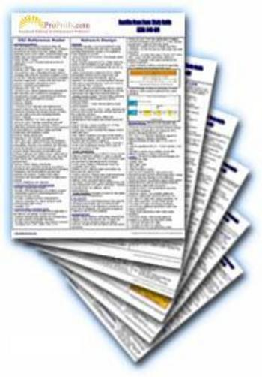
4. Guidance Pack (Dean’s Advice)
Included in the Guidance Pack:
Guidance Pack
Disciple Maker Teaching
Student’s Handbook
Student Registration Guide
Dean’s Handbook
Centre Guide — (Info for Tuition Centre)
Study Fees Phase 1 to PhD (2016)

Slide 9
5. Administration Pack
Administration Pack — (How to run a Tuition Centre)
Phase Assignments & Tests — (Requirement summary)
Phase 1 Programme Admin — (Budgeting pps)
Phase 2 Programme Admin — (Budgeting pps)
Ministry Textbook Prices — (When TC buys — 2016)
Student Registration Forms — (CLT and University)
CLT Admin — (Excel programme, being replaced by CAP)

Slide 10

6. Reporting Pack
This pack comprises:
Financial Planner (PDF & Excel document)
Reporting Pack (Introduction)
Yearly April Report (One page summary)
Class Results Record (2016 on CAP)
Disciple Making Record

Slide 11
7. Graduate Pack
Graduate Pack — (Introduction)
Phase Assignments & Tests — (Requirement summary)
Bachelor Prospectus 4/5 & 27 — (Modules and Topics)
Assignment Guide — (Describing the written work to be done)
Praxis Phase 27 — (Sample of practical work assignments)
Graduate Study Guide — (Partial Sample Pdf)
Diploma for B.Min Bridging Courses

Slide 12

Pray, Take Action
Ask for God’s wisdom
Complete the Applicant Data form and fax to: 012 567 5550
Read all the Packs
Print only what is necessary
Get the Concise Prospectus to promote a new Bible School
Now, register and start!
More Web Info: www.clt.org.za

